Slide 1
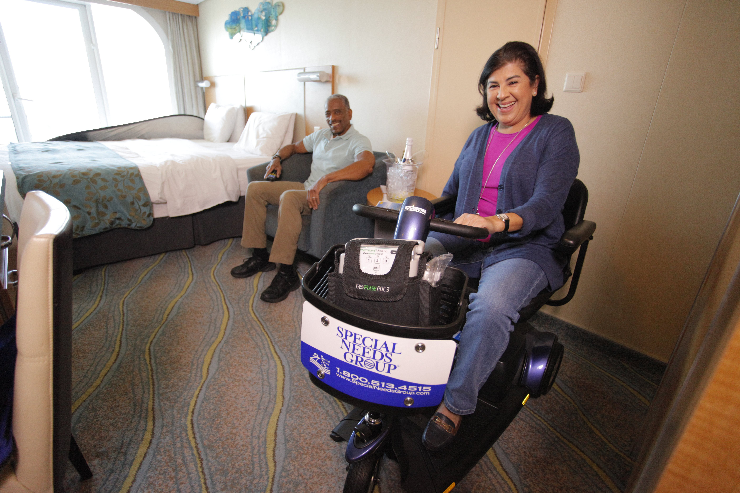

Making Travel Accessible
(Insert name of organization/audience you are presenting for)
(insert date)
(ADD YOUR LOGO HERE)
In conjunction with

Slide 2
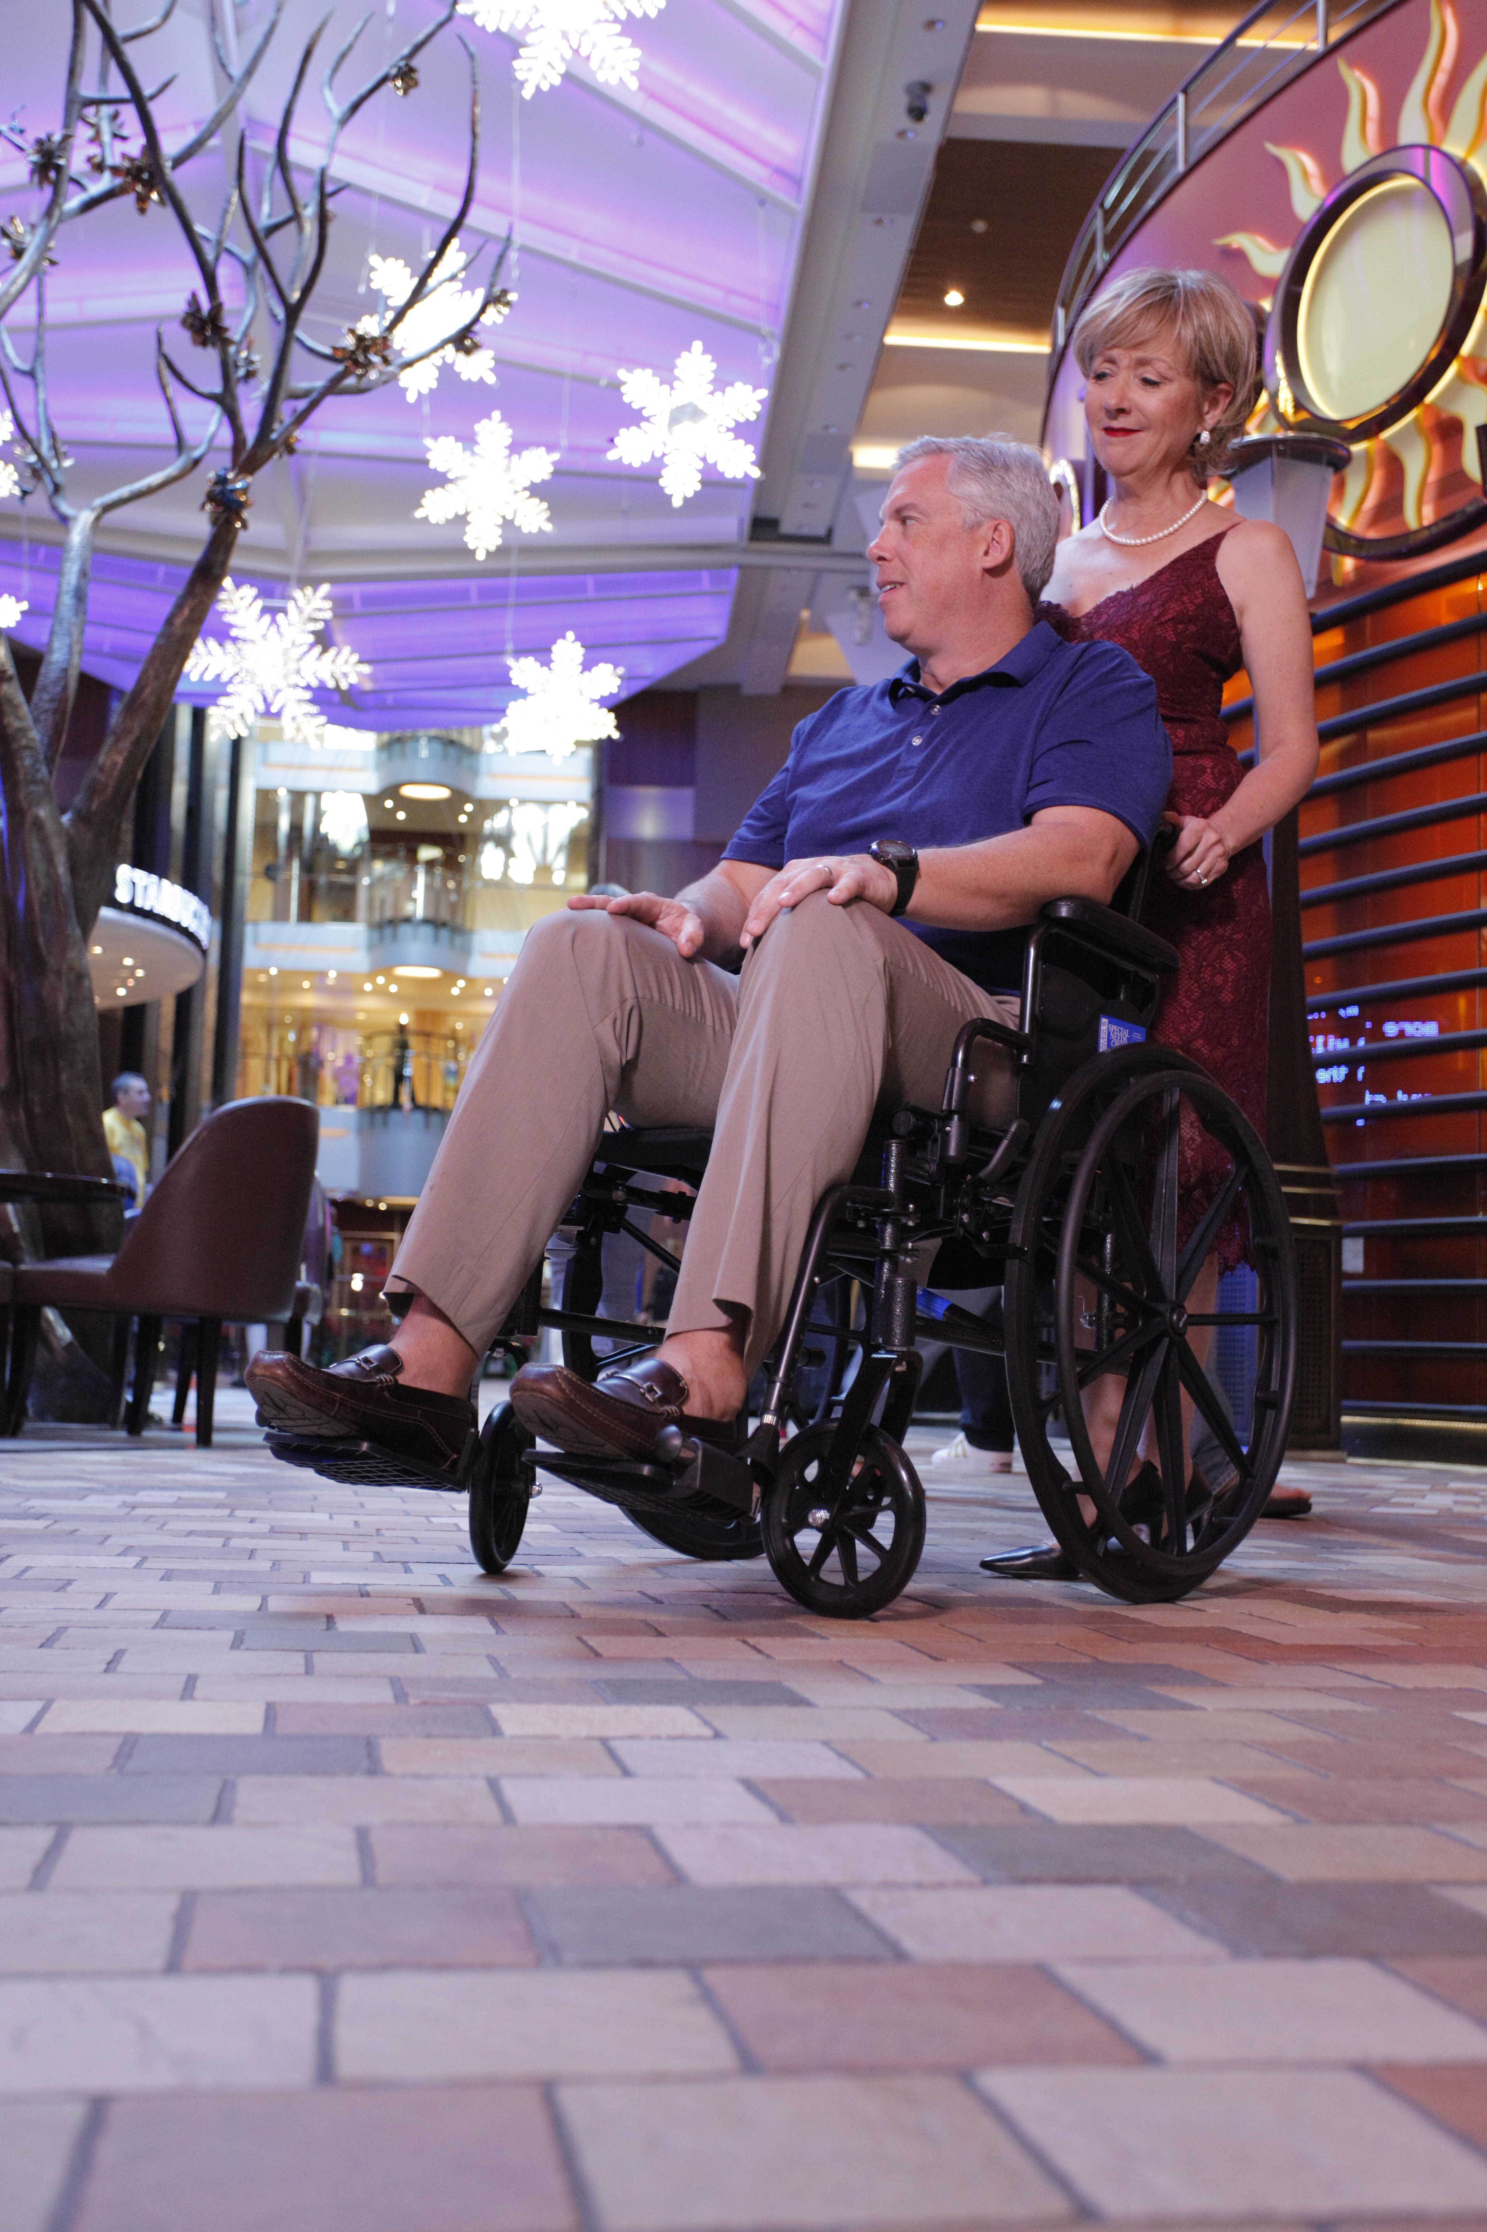
Cruising as an accessible vacation
Is mobility equipment right for me?
Special Needs Group
Equipment information
(ADD YOUR LOGO HERE)

Slide 3
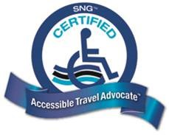
Look for a Travel Advisor who is a proud SNG Certified Accessible Travel Advocate!
(ADD YOUR LOGO HERE)

Slide 4
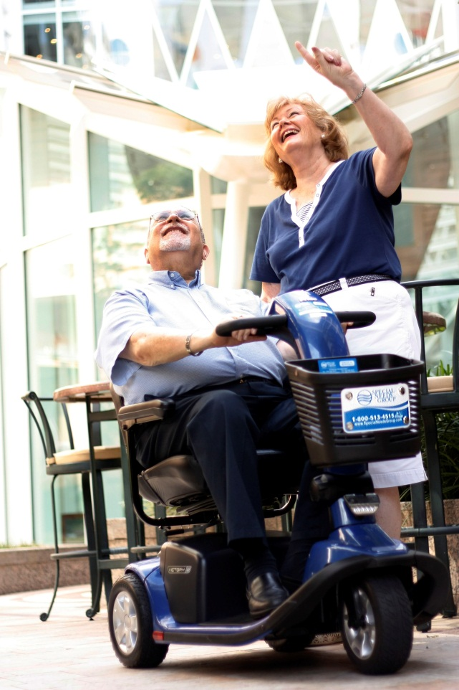
  Did you know?
12% of people with disabilities in the U.S. have taken a cruise in last 5 years (Open Doors Organization study)
Compare to 10% of the total U.S. population in the last 3 years (Cruise Line International Association report)
Cruise Ships are Getting Larger
  Royal Caribbean’s Allure of the Seas: 1,188 ft
  Holland America Line’s Nieuw Amsterdam: 936 ft
HOW ARE THEY ABLE TO DO IT?
(ADD YOUR LOGO HERE)

Slide 5
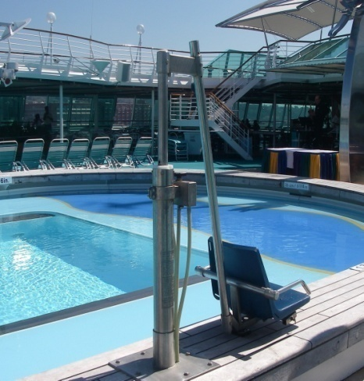
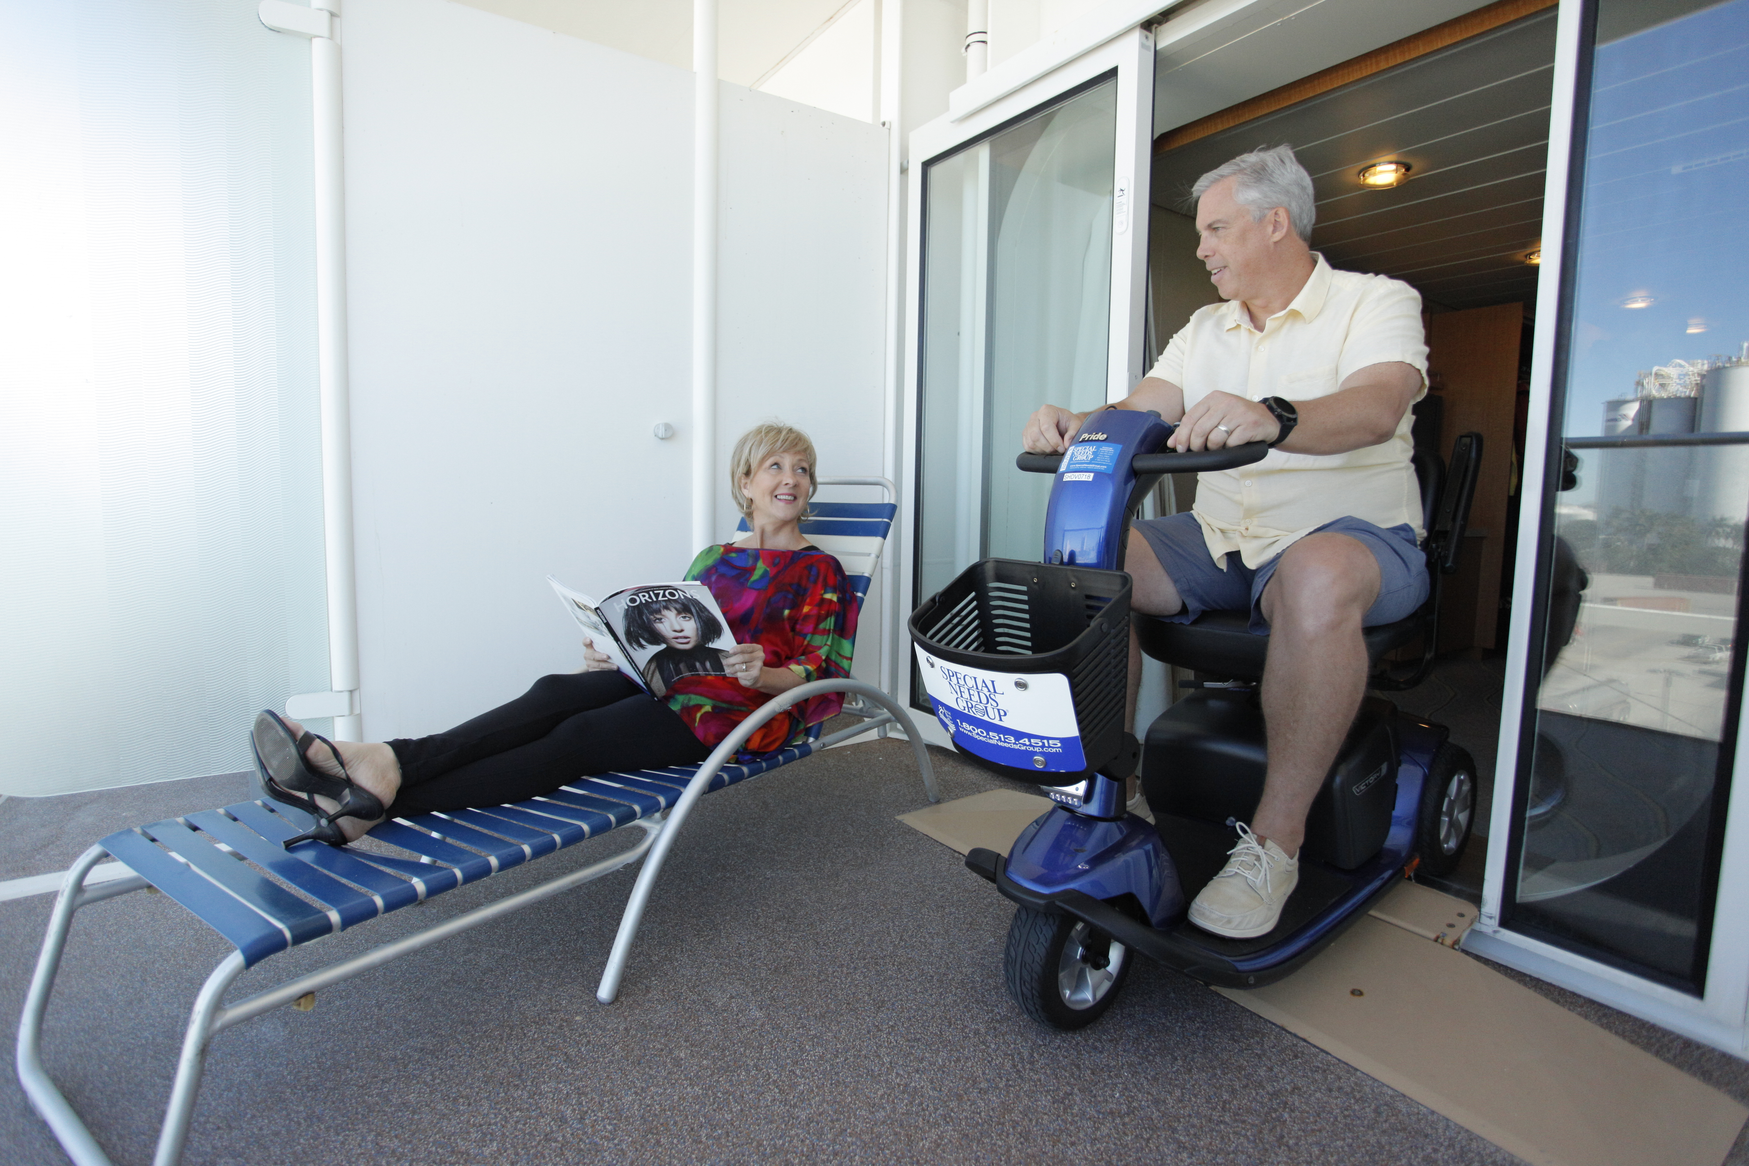
Accessible Staterooms
Pool and Stateroom Lifts
Automatic Doors, Ramps
Assistive Listening Devices
Portable Room Kits
Braille, Tactile, Large Print
What makes cruising accessible?
(ADD YOUR LOGO HERE)

Slide 6
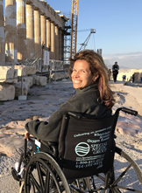
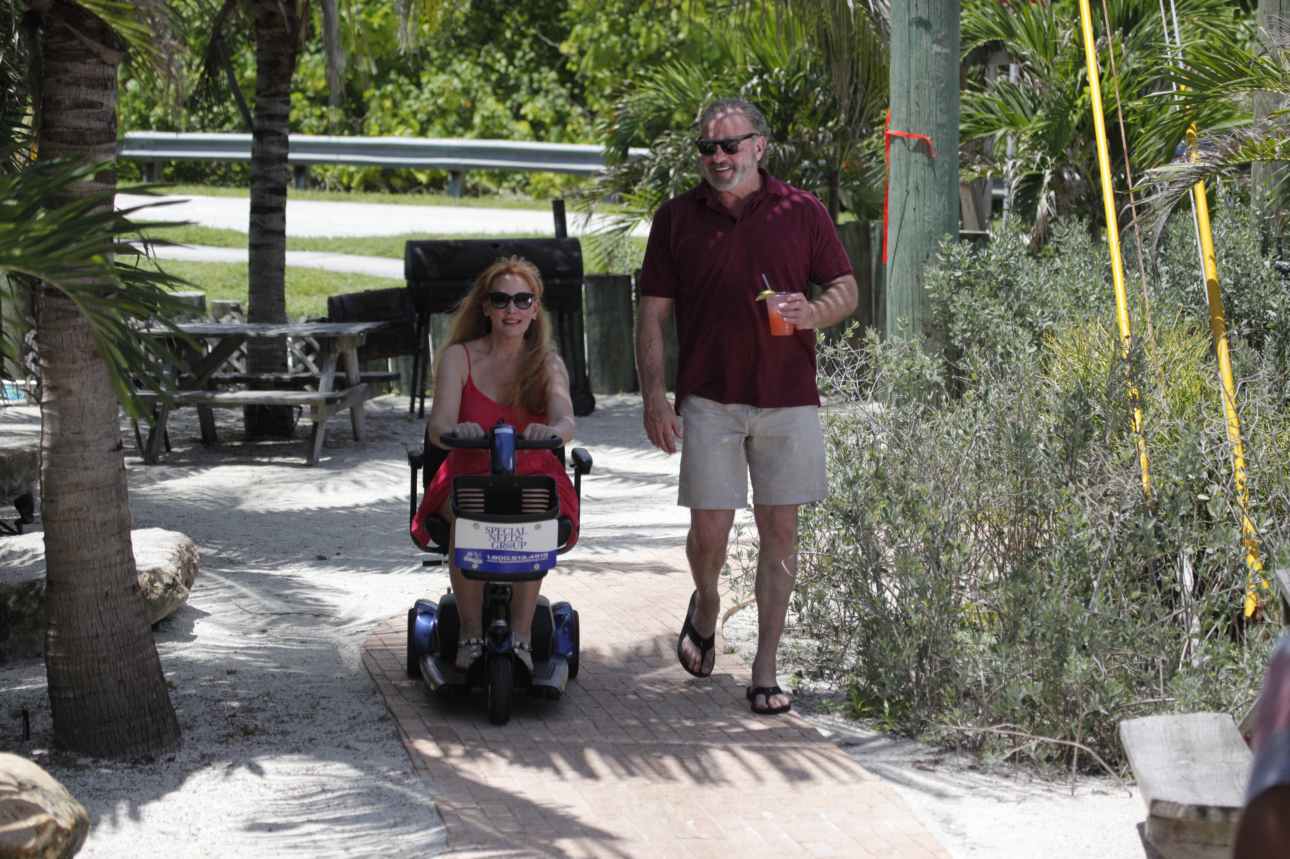
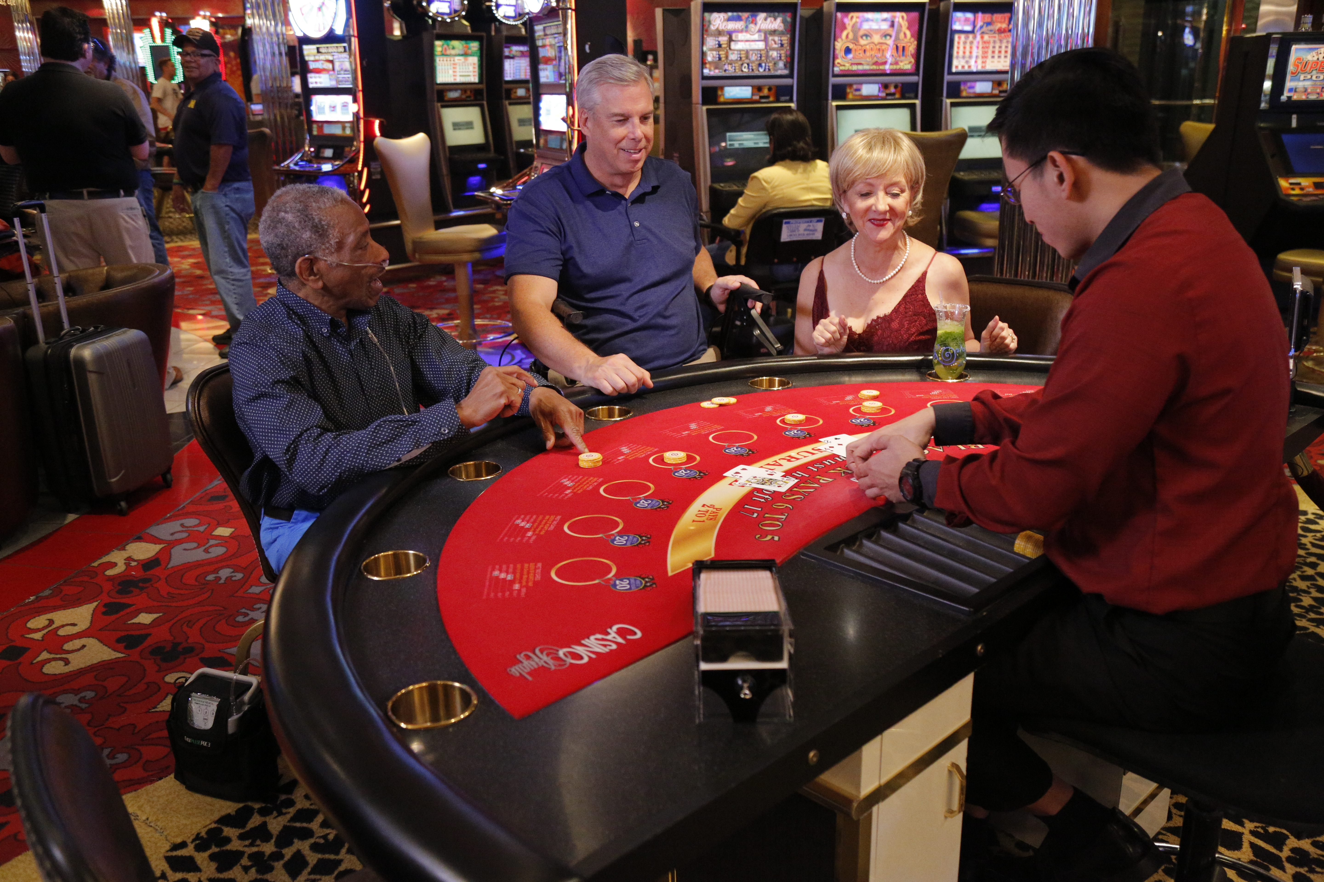
Ask Yourself the Following Questions:
Do you or anyone in your party have mobility issues or problems walking long distances?
Are there any physical activities you or any member of your group find difficult (e.g., negotiating stairs, standing from a seated position, etc.)?
Are you planning to book any excursions as part of your vacation?
Will you or anyone in your group have trouble keeping pace on the excursions?
If you answered “Yes” to any of these questions, you would benefit from using mobility and/or respiratory equipment! Make sure to have a conversation with your Travel Advisor about what equipment is right for you.
(ADD YOUR LOGO HERE)

Slide 7
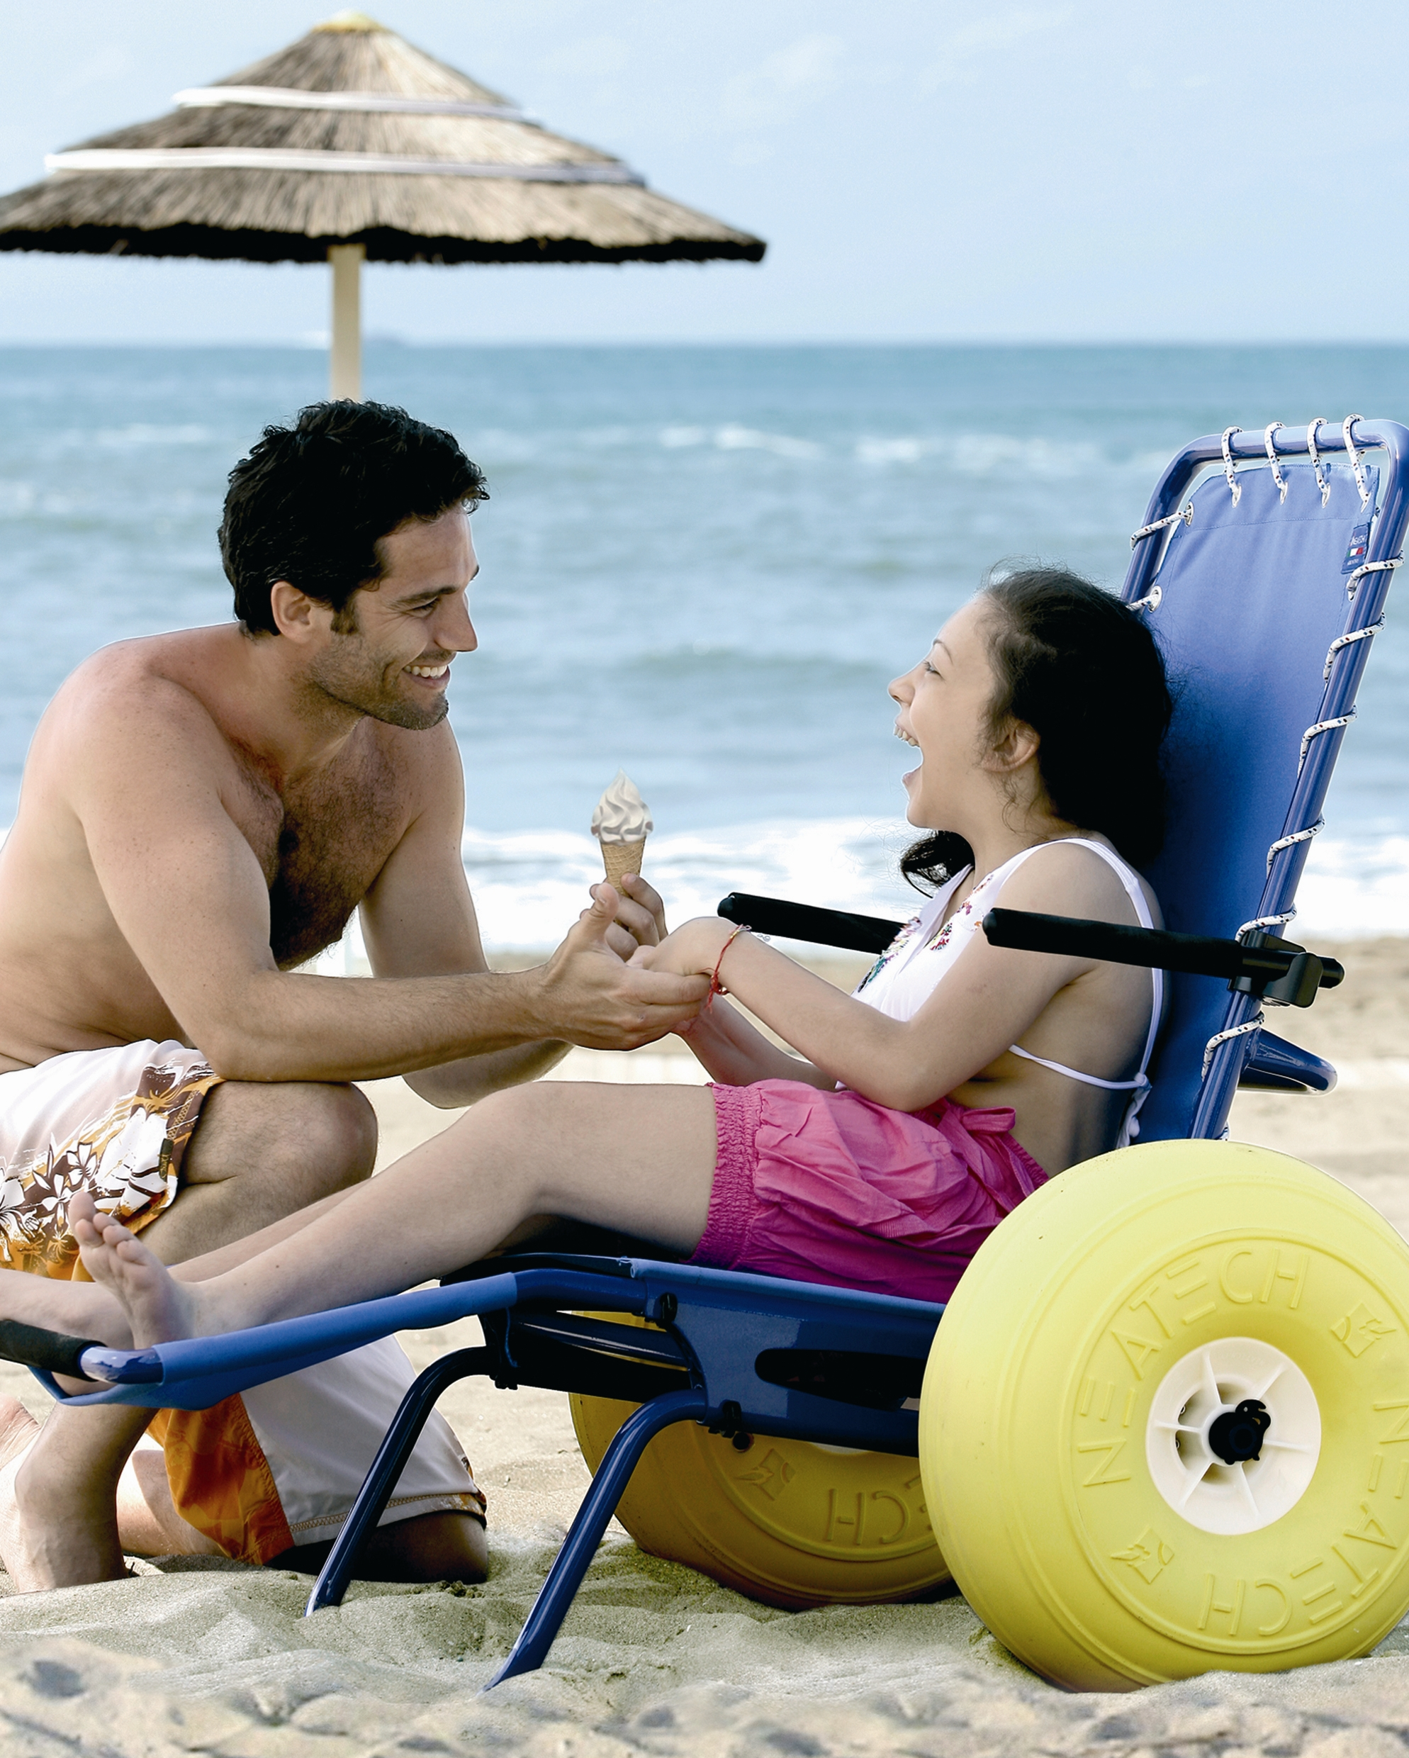
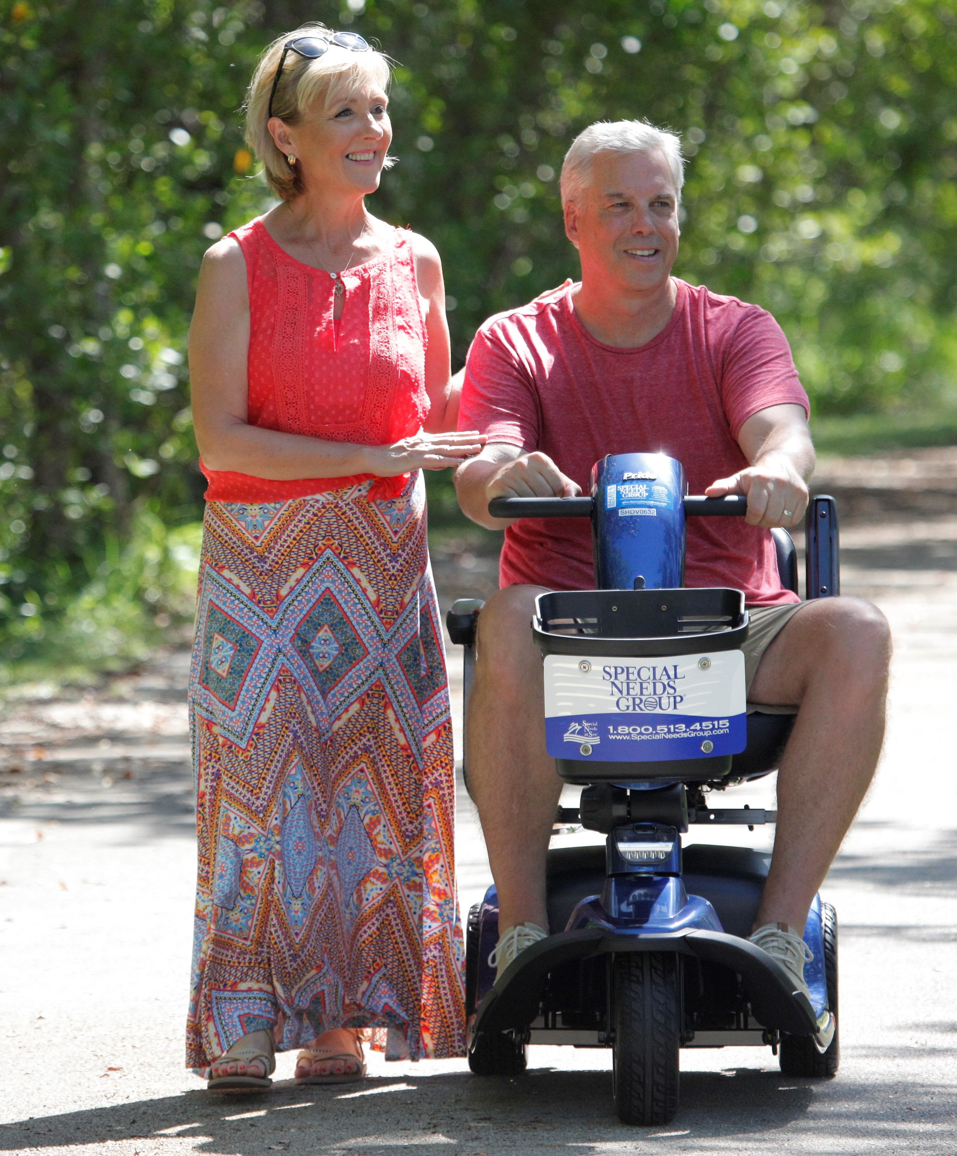
About Special Needs Group – Delivering an Accessible World™
Dedicated to fulfilling the mobility, oxygen, and other special need requirements for the traveling public
Headquartered in Ft. Lauderdale area – the hub of the cruise industry!
Over 15 years in business handling special needs/special requests
Serviced over 217 cities and ports in over 70 countries
White Glove Service advantage – personalized delivery and demonstration service
Preferred supplier of major cruise lines
Emergency assistance 24 hrs/day, 7 days/week
SNG services hotels, convention centers, and theme parks too!
(ADD YOUR LOGO HERE)

Slide 8
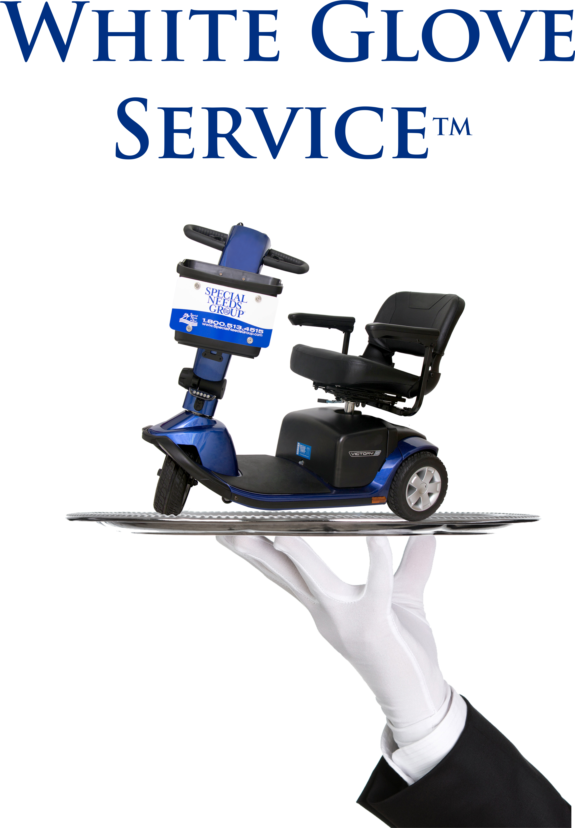
SNG White Glove Service™
Personalized Delivery and Demonstration Service
Elevating The Guest Experience in Four Simple Steps
Guest calls upon arriving on port property
Guest is met by SNG Guest Experience Ambassador™ where Equipment is delivered, demonstrated and any questions are answered prior to entering the terminal
Guest calls Experience Ambassador at last breakfast or when cleared for early debarkation
Guest Experience Ambassador meets guest to pick up equipment and solicits guest feedback
Ask us for more details!
(ADD YOUR LOGO HERE)

Slide 9
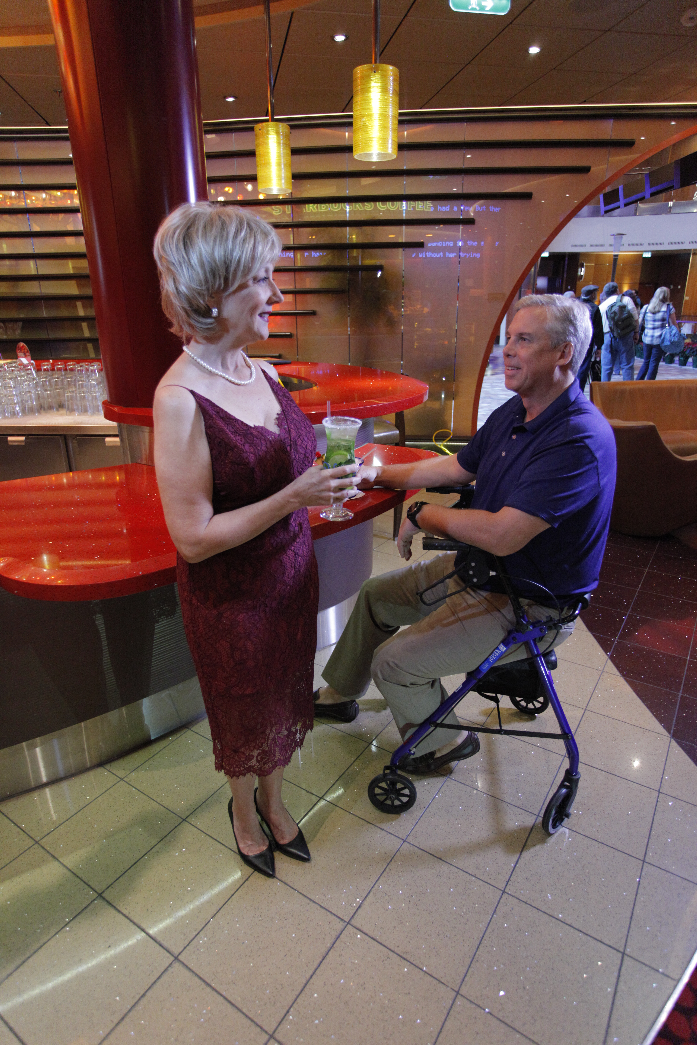
Placing an Order is So Easy!
Please call or visit our website: (insert your website here)
We will need:
Contact Info – Full Name, Address, Telephone, Email
Equipment Desired – Type
For Mobility Items – Height & Weight of User
For Oxygen Items – Type of Equipment Used at Home
Liter Flow Per Minute (LPM)
How Many Hours Used Per Day
Do You Need Oxygen for a Flight
Prescription or Certificate of Medical Necessity Required
Payment Info – Full Credit Card Info Taken at Time of Booking
(ADD YOUR LOGO HERE)

Slide 10

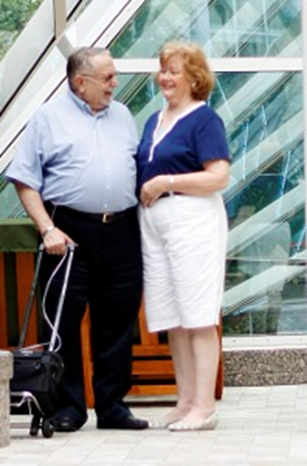
RESERVATION OF EQUIPMENT IS NOT GUARANTEED UNTIL CREDIT CARD PAYMENT IS CONFIRMED
Mobility
  Wheelchairs are fully collapsible and fit into any stateroom
  Scooters for passengers weighing less than 350 lbs. will fit in most standard cruise ship cabins – scooters for people larger than 350 lbs will only fit in accessible cabins
  Powerchairs are only rented to users who use a powerchair on a daily basis and all powerchairs require use in an accessible cabin
  Scooters and powerchairs require nightly charging
Oxygen
  Availability of cylinders and liquid oxygen are more limited in ports outside of the U.S.
  Liquid oxygen is not allowed on all cruise ships
  Each airline has its own approved list of personal oxygen concentrators
Some Things to Remember
(ADD YOUR LOGO HERE)

Slide 11

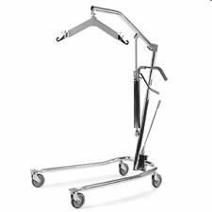
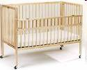
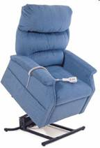
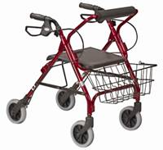
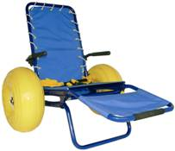
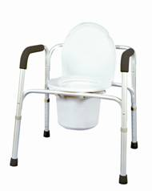
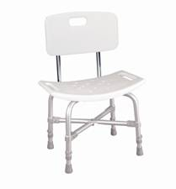
Additional Equipment Available
Hospital Beds
(please check with the cruise line)
Patient Lifts
Baby Cribs
Lift Chairs
Walkers/ Rollators
Beach/Pool Wheelchairs
Commode Chairs
(with/without wheels)
Shower Chairs
(ADD YOUR LOGO HERE)
Notes:
11

Slide 12

Hearing-impaired equipment
Visual-impaired equipment
Animal relief materials for service animals
Braille printing
And more - just ask!
Special Needs Group Offers Other Services
(ADD YOUR LOGO HERE)

Slide 13
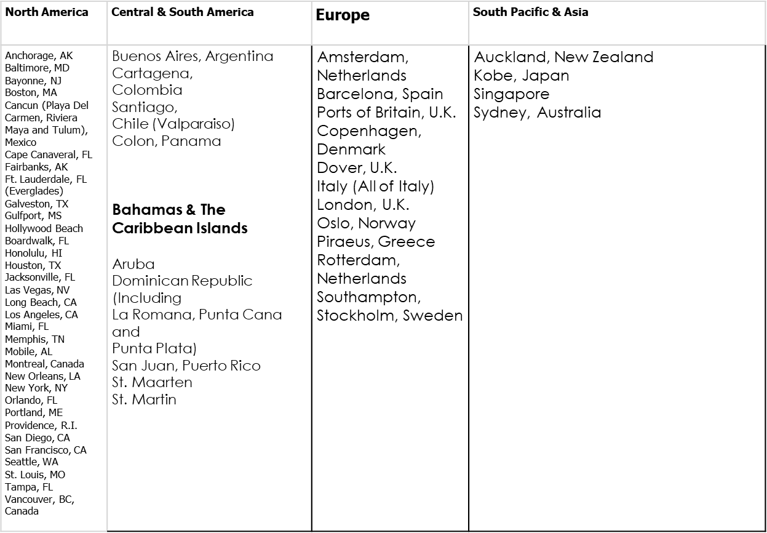

SNG Currently Serves 217 Metropolitan
Areas 70 Countries
True Global Footprint
(ADD YOUR LOGO HERE)

Slide 14
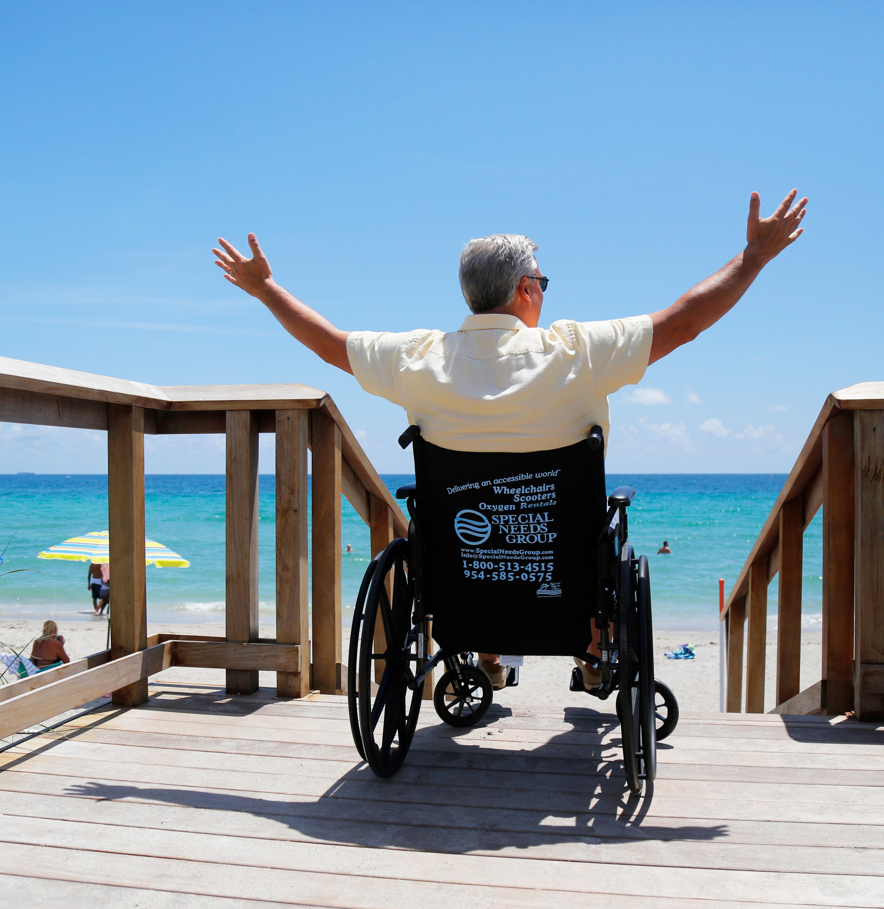
Questions?
Add your logo and contact info here
(ADD YOUR LOGO HERE)

